Slide 1
Tuto SimCLR

Slide 2
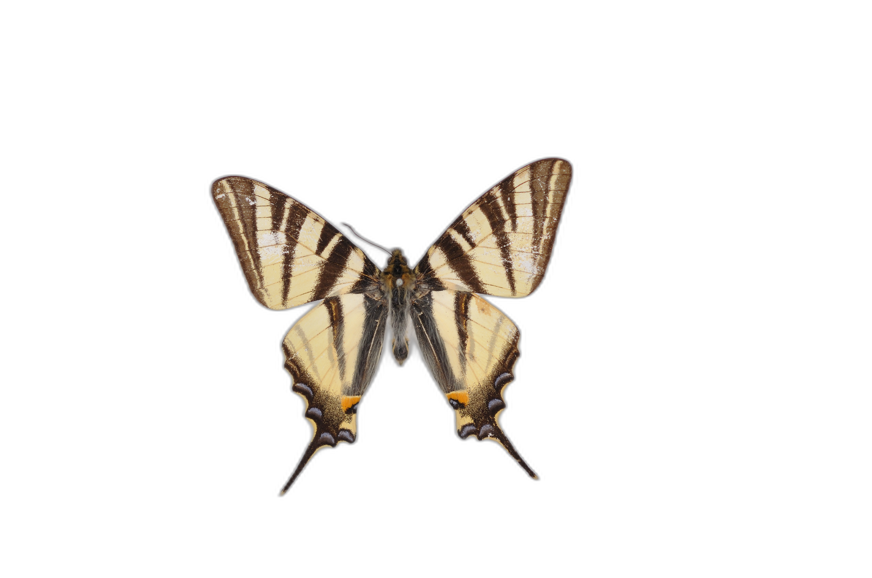
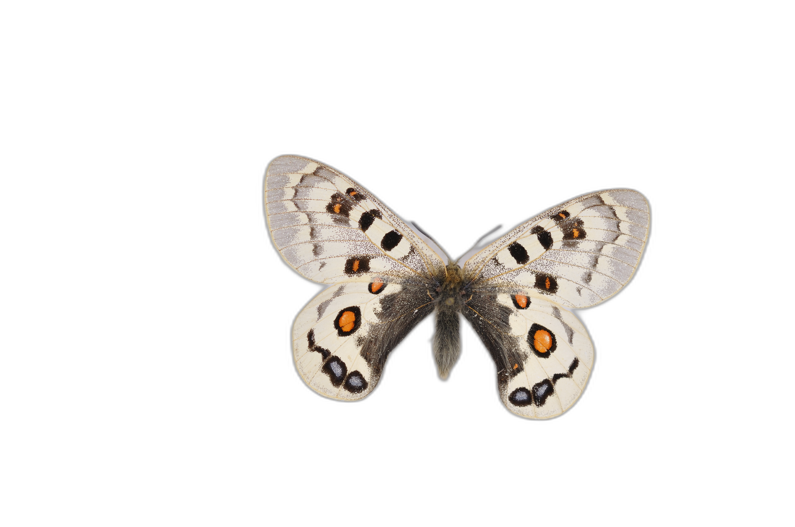
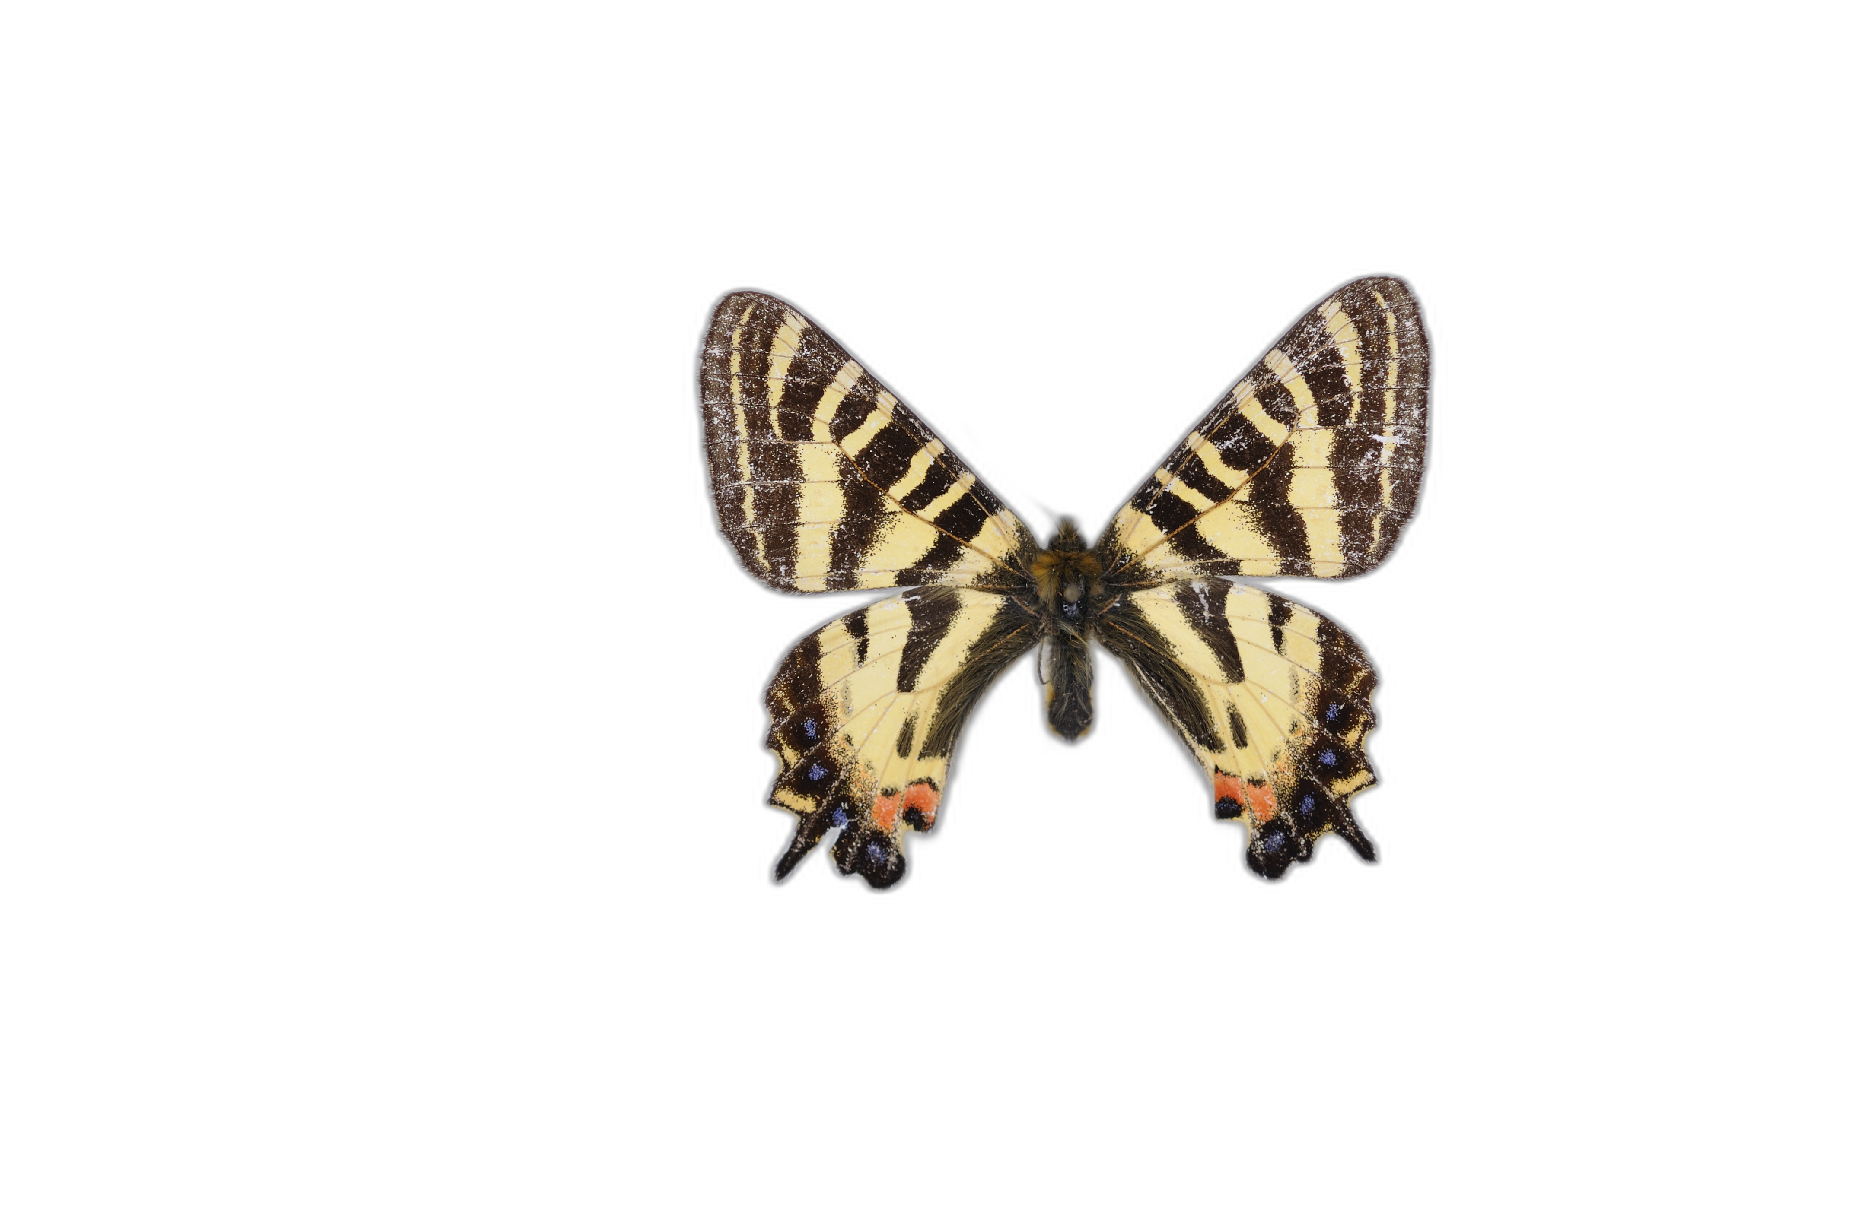
Objectives
Goal : quantify colour pattern similarity
Freedom from shape variation
Obtain a relative distance measure between all colour patterns
Notes:
Développement de la méthode de quantification

Slide 3
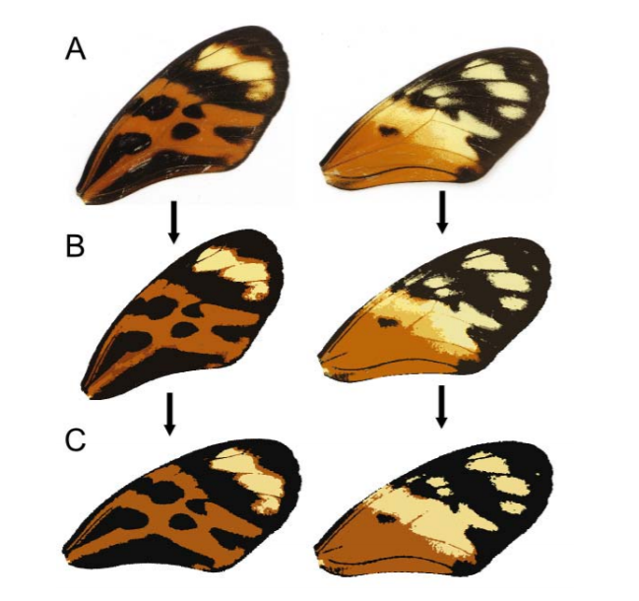
Quantification methods
Homology based methods: CPM, patternize
Notes:
Développement de la méthode de quantification

Slide 4

Quantification methods
Homology based methods: CPM, patternize
Pixel precise quantification and visualisation of variation
Notes:
Développement de la méthode de quantification

Slide 5

Quantification methods
Homology based methods: CPM, patternize
Pixel precise quantification and visualisation of variation
Alignment necessary, colour segmentation step
Notes:
Développement de la méthode de quantification

Slide 6
Quantification methods
Homology based methods: CPM, patternize
Pixel precise quantification and visualisation of variation
Alignment necessary, colour segmentation step
Machine learning based methods
Notes:
Développement de la méthode de quantification

Slide 7

Quantification methods
Homology based methods: CPM, patternize
Pixel precise quantification and visualisation of variation
Alignment necessary, colour segmentation step
Machine learning based methods
« Black box », no complete control over shape variation, need for labels
Notes:
Développement de la méthode de quantification

Slide 8
Quantification methods
Homology based methods: CPM, patternize
Pixel precise quantification and visualisation of variation
Alignment necessary, colour segmentation step
Machine learning based methods
« Black box », no complete control over shape variation, need for labels
Large scale colour pattern comparison possible, no bias in colour segmentation
Notes:
Développement de la méthode de quantification

Slide 9
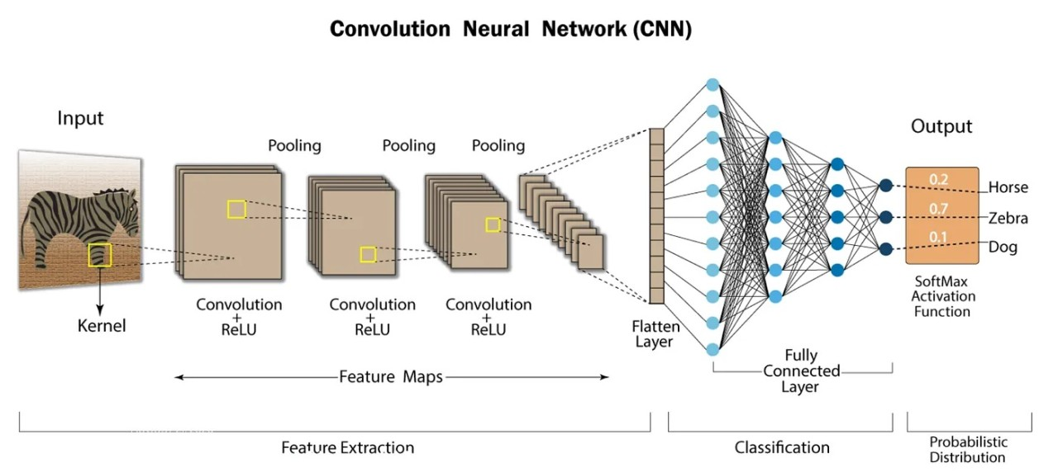
Convolution filters

Slide 10
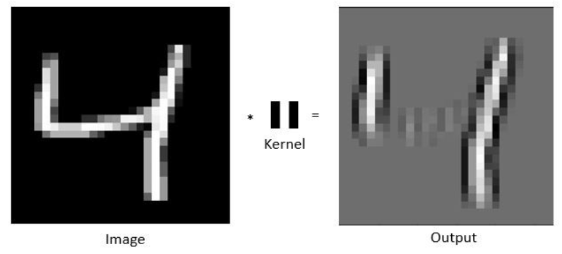
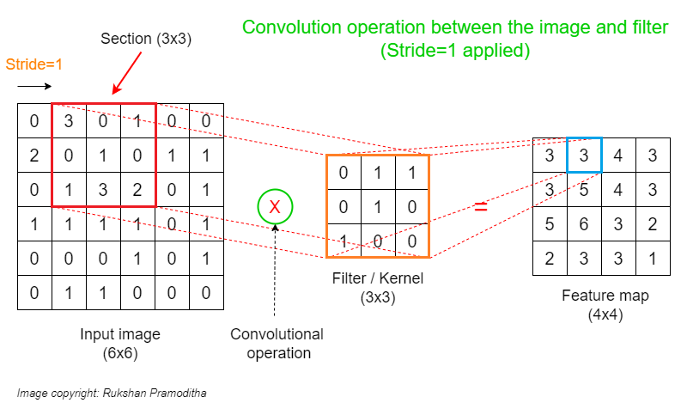
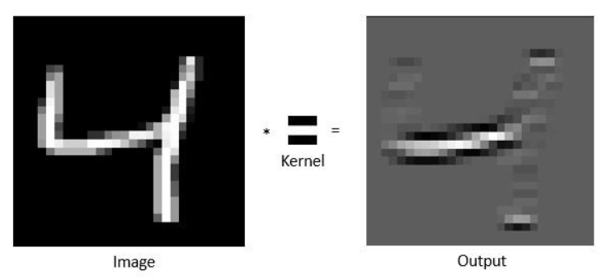
Convolution filters

Slide 11
« Neuron »

Slide 12
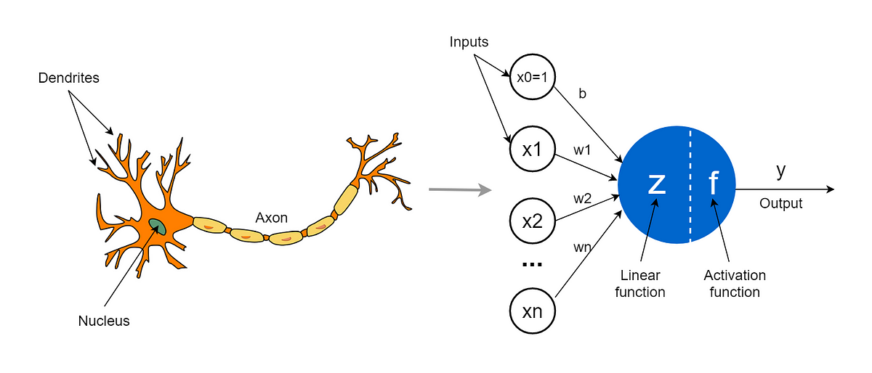
« Neuron »

Slide 13
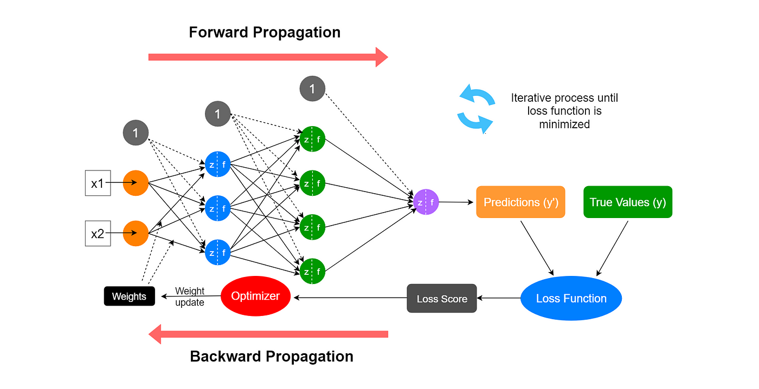
Neural network

Slide 14
https://www.youtube.com/watch?v=HGwBXDKFk9I&ab_channel=StatQuestwithJoshStarmer

Slide 16
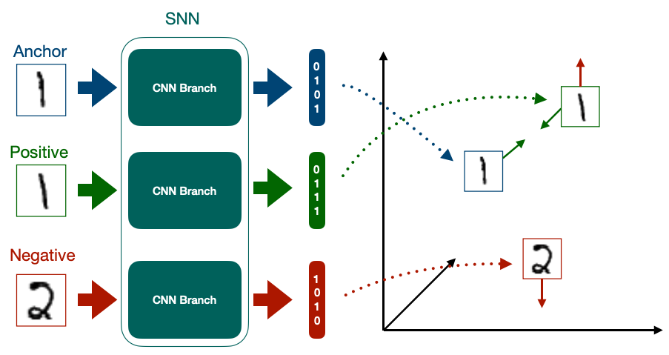
Discriminative
Metric learning
Siamese network

Slide 17
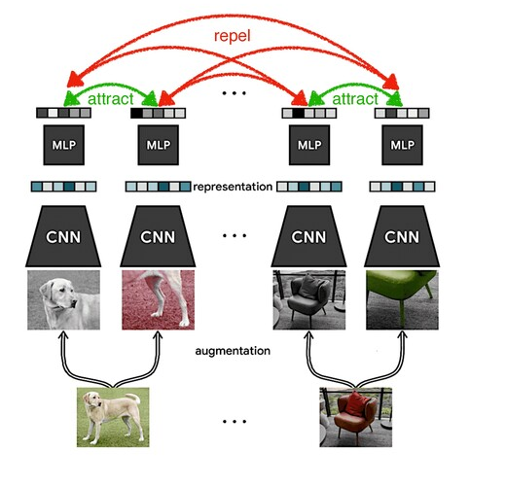
SimCLR a Simple Framework for Contrastive Learning of visual Representations
Chen, Ting, Simon Kornblith, Mohammad Norouzi, et Geoffrey Hinton. « A Simple Framework for Contrastive Learning of Visual Representations ». arXiv:2002.05709 [cs, stat], 30 juin 2020. http://arxiv.org/abs/2002.05709.
Self supervised learning
Crucial choice of augmentations
Relative distance latent space

Slide 18
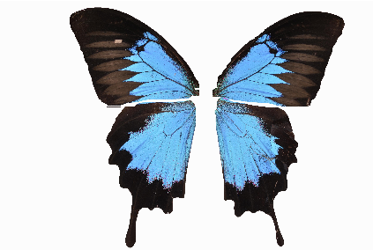
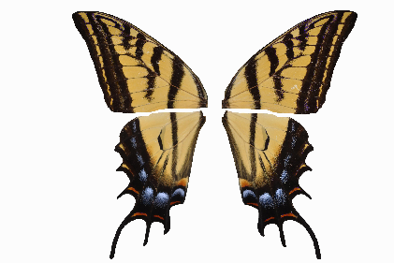

Slide 19
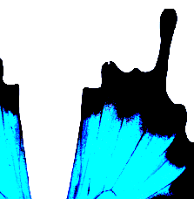
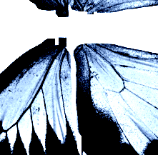
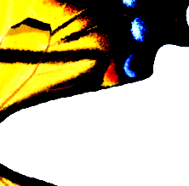
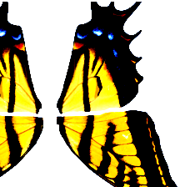
Crop
Rotations
Flipping
Shape-based augmentations
Grayscale
ImageNet normalization
No other colour augmentations
For pattern recognition

Slide 20
Anchor
Positive
Negative

Slide 21
Anchor
Positive
CNN
Negative

Slide 22
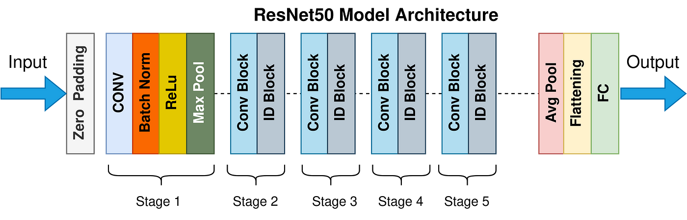
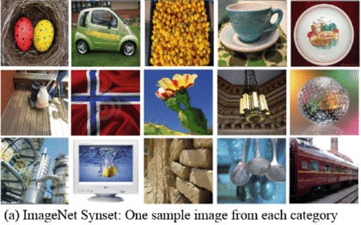
Anchor
MLP
Positive
ResNet-50
PRETRAINED
Negative

Slide 23
Anchor
0101
Positive
ResNet-50
0111
Negative
1010

Slide 24
Anchor
0101
Positive
ResNet-50
0111
Negative
1010

Slide 25
Anchor
0101
Positive
ResNet-50
0111
Negative
1010
XNT-Loss

Slide 26
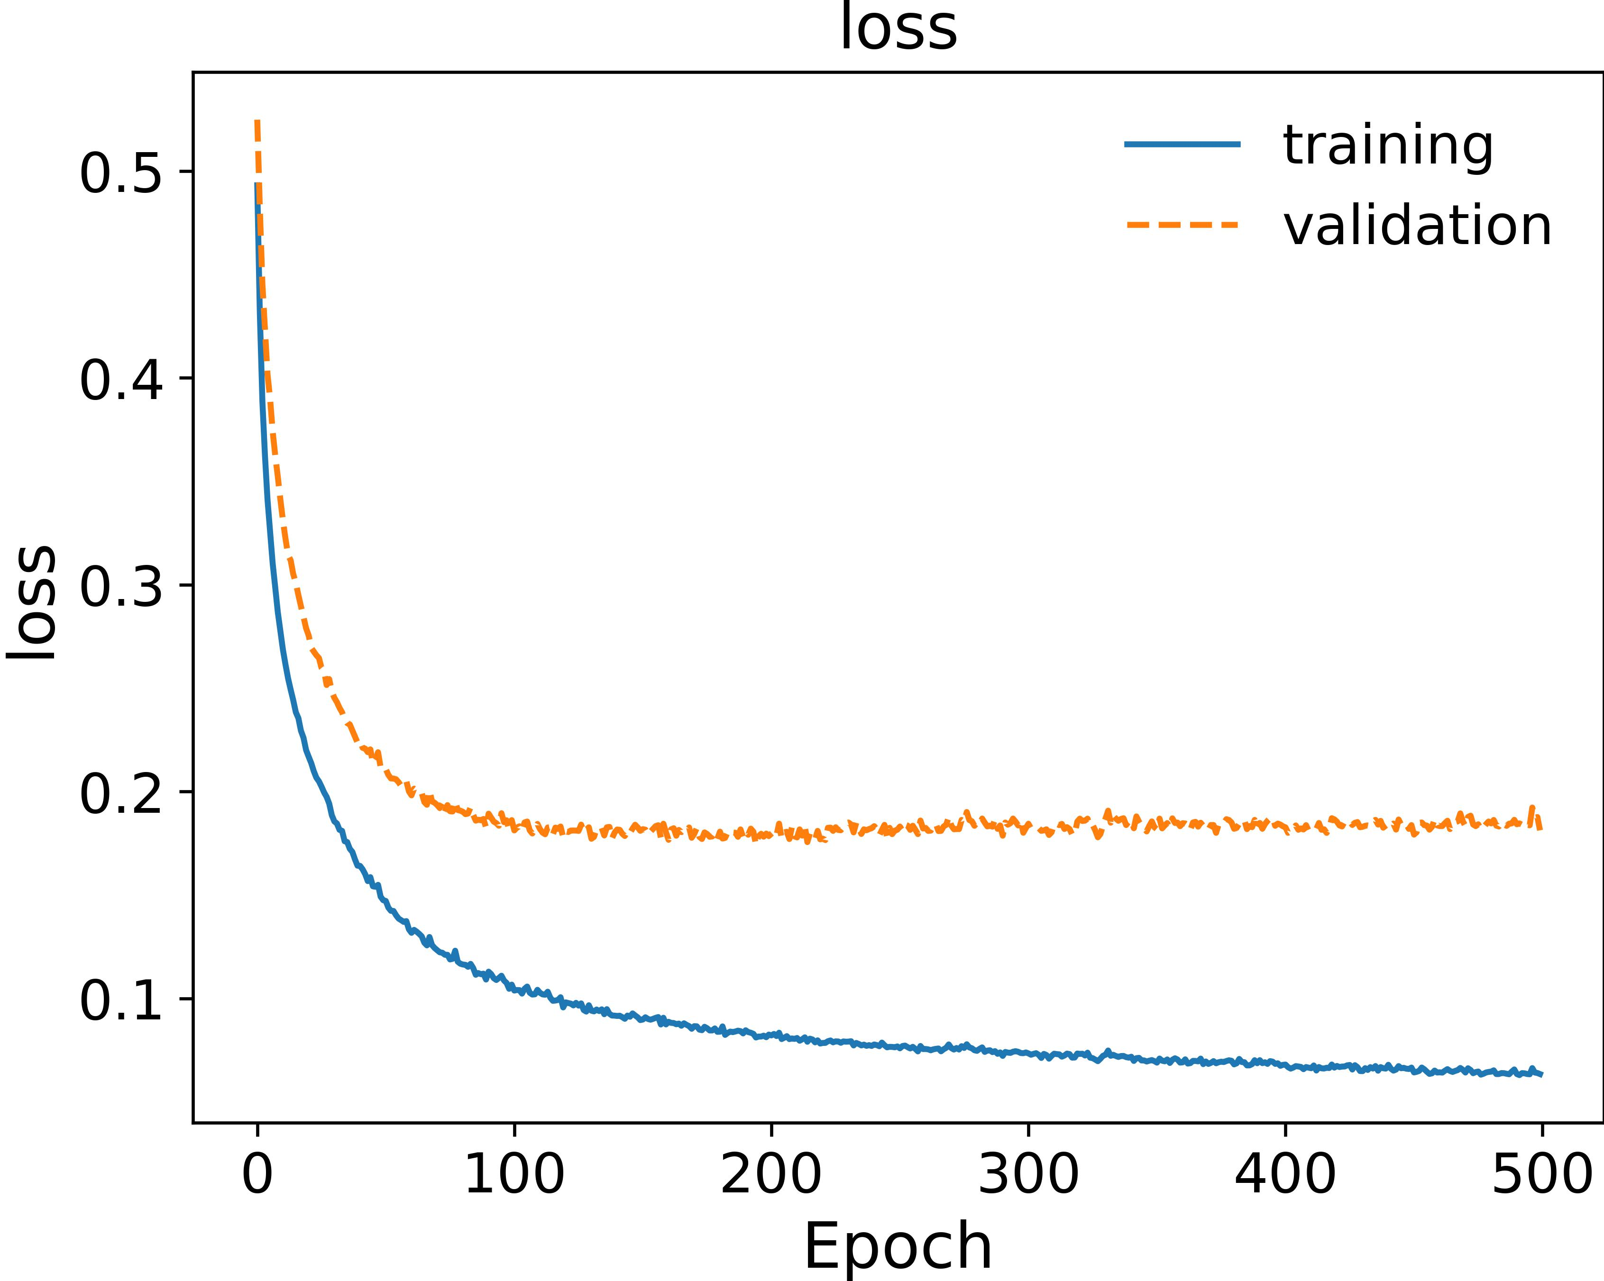
Model hyperparameters and model training
Hyperparameters: parameters that the user has to set
Temperature: a parameter within the loss function that controls the strength of repelling and attracting
Batch size: number of images fed to the neural network each epoch, from which negative examples are found (the larger, the better)
Epoch number: duration of the training
Model architecture: Resnet50 in our case, but could be changed

Slide 27
What about model validation ?
Ground truth and hyperparameters

Slide 28
Hyperparameters
ResNet-50
Temperature Batch size Epoch number
?
?
?
Evaluation using a « pretext » task such as classification
What do we use as labels ?

Slide 29
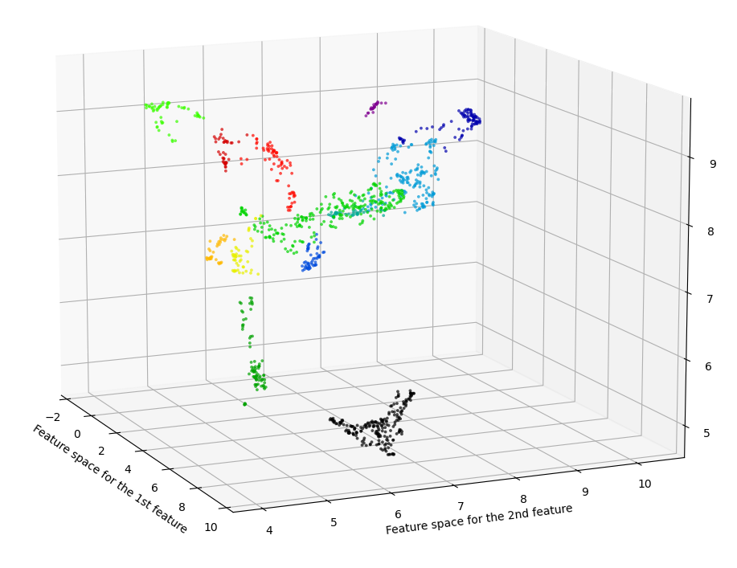
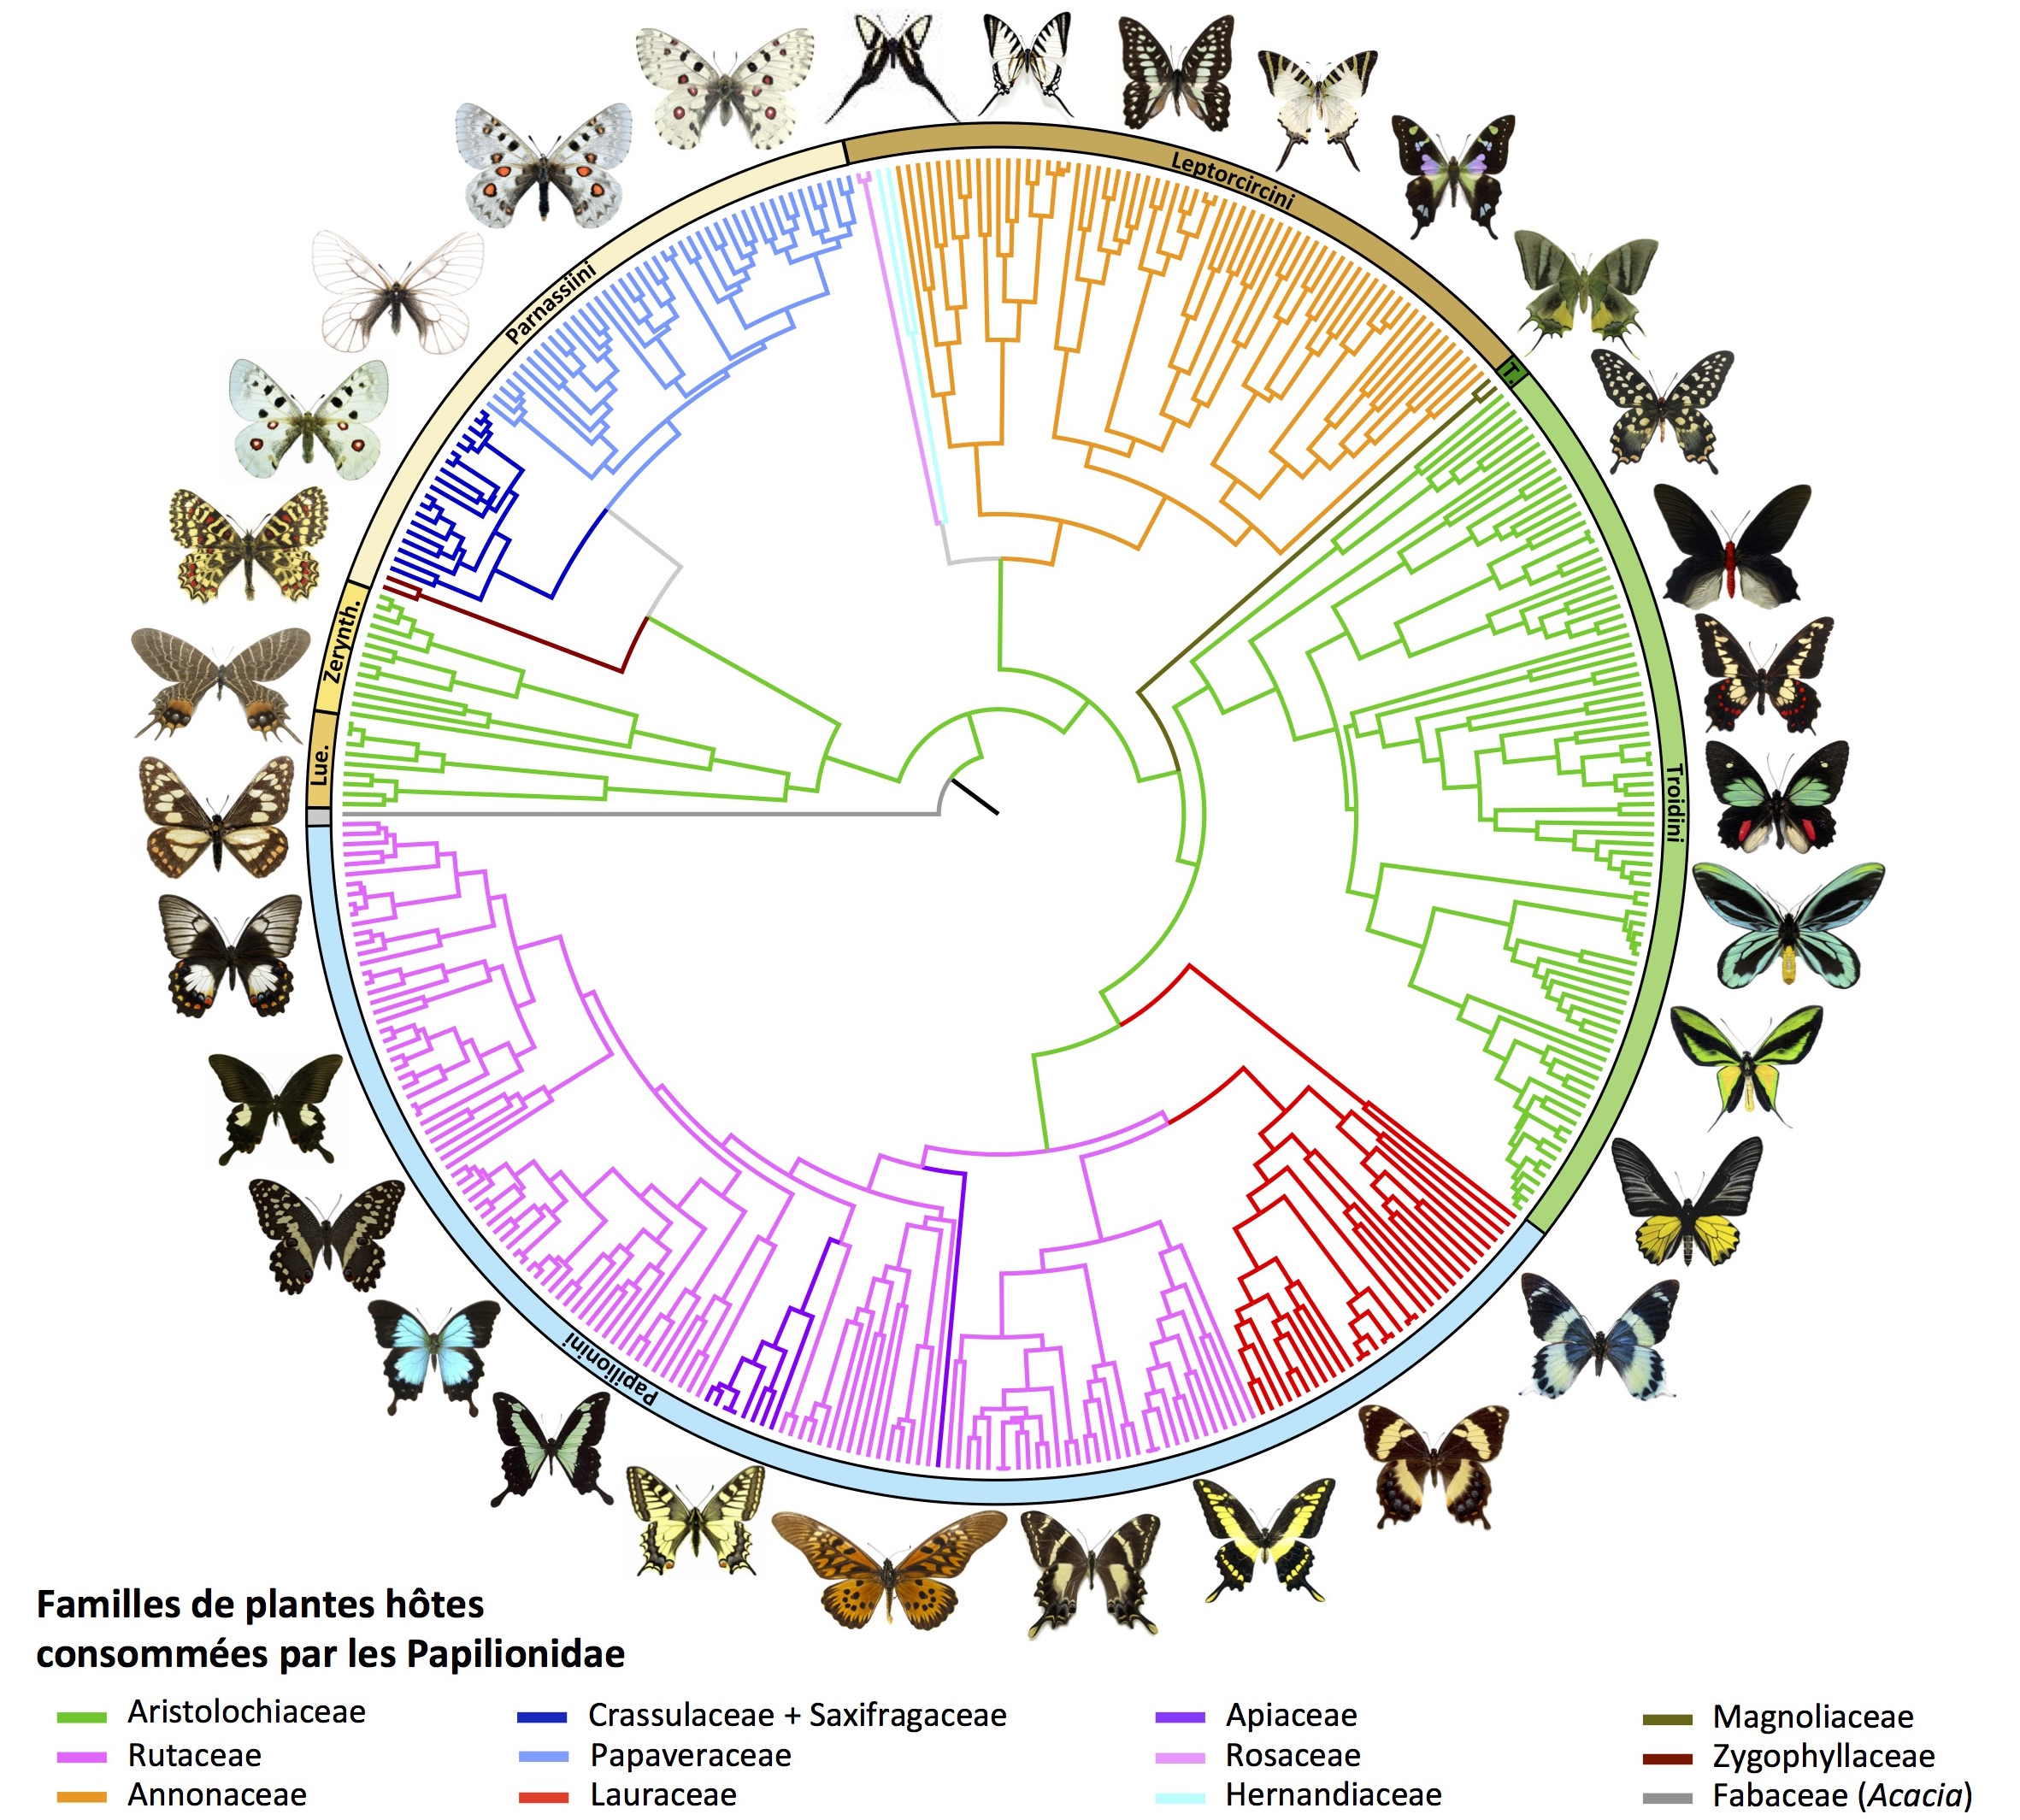
Hyperparameters
ResNet-50
Temperature Batch size Epoch number
?
?
?
Evaluation using a « pretext » task such as classification
Coarse phenotypic clusters
Genus

Slide 30
Unsupervised training
SimCLR
Labels
FROZEN
No weights modification
Features
Classifier
Supervised model evaluation
Accuracy
+ other measures

Slide 31
SimCLR
Base model
« Null » model
Unsupervised training
SimCLR
Resnet-50 pretrained
Resnet-50 pretrained
Labels
Features
Features
Features
Classifier
Classifier
Classifier
Accuracy
+ other measures

Slide 32
Hyperparameters
ResNet-50
Temperature Batch size Epoch number
0,5
128
300
Pretrained Resnet-50
Fine-tuned Resnet-50
SimCLR
F1 score : 0,97
Kappa : 0,96
Accuracy : 95 %
F1 score : 0,84
Kappa : 0,81
Accuracy : 84 %
F1 score : 0,88
Kappa : 0,86
Accuracy : 87 %

Slide 33
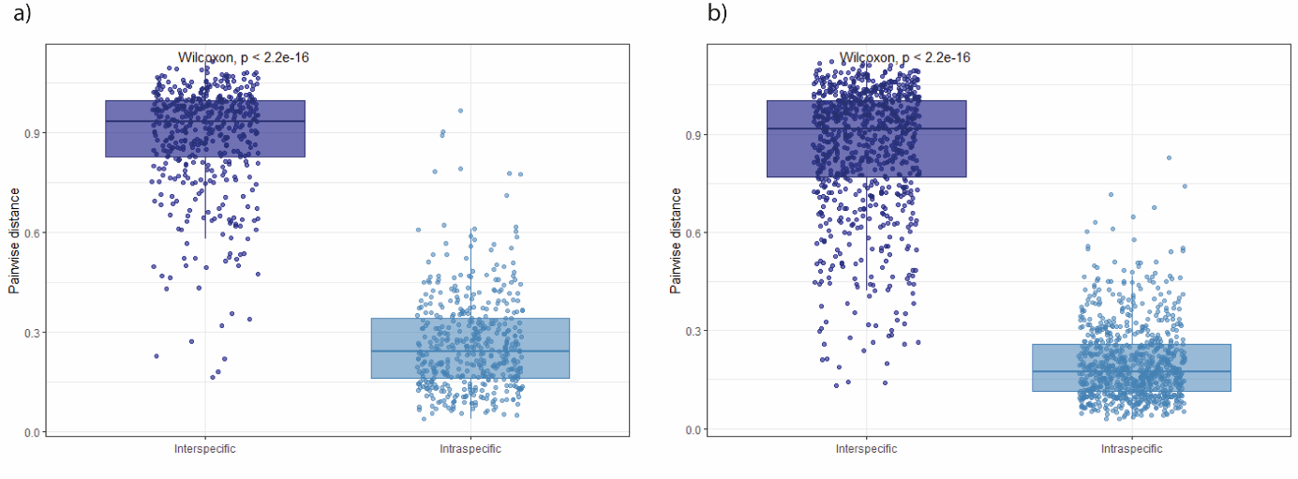
Inter vs intraspecific phenotypic distance
Males
Females
At the genus level as well

Slide 34
Visualisation
Explainability

Slide 35
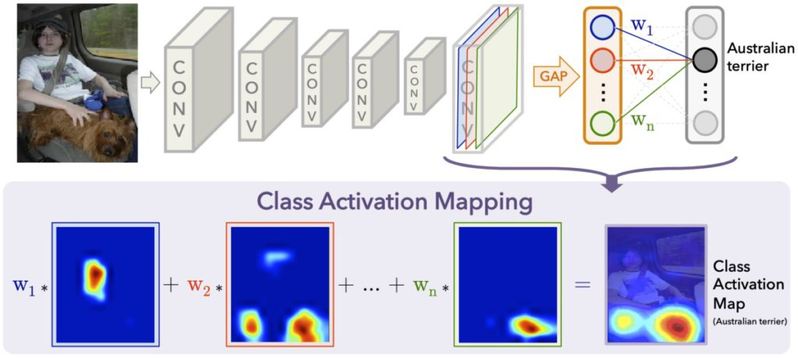
Grad-CAM

Slide 36
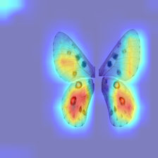
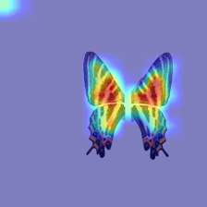
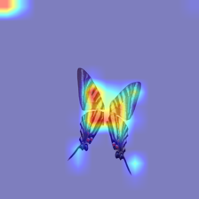
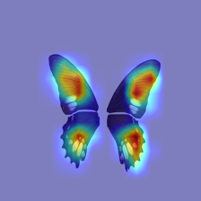
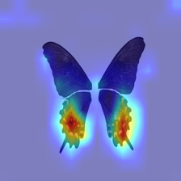
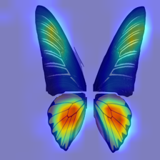
Grad-CAM

Slide 37
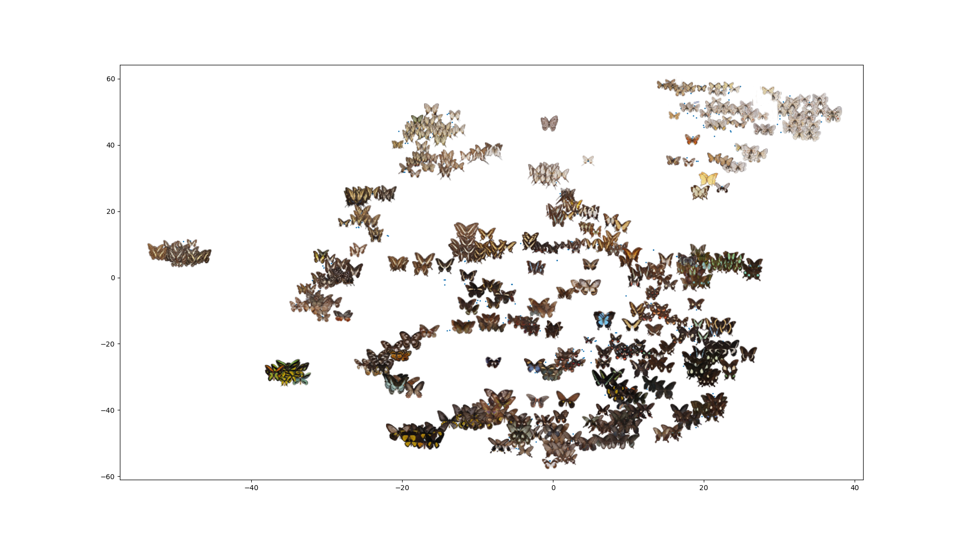
Morpho space
TSNE
Notes:
Premières analyses + idées ?

Slide 38
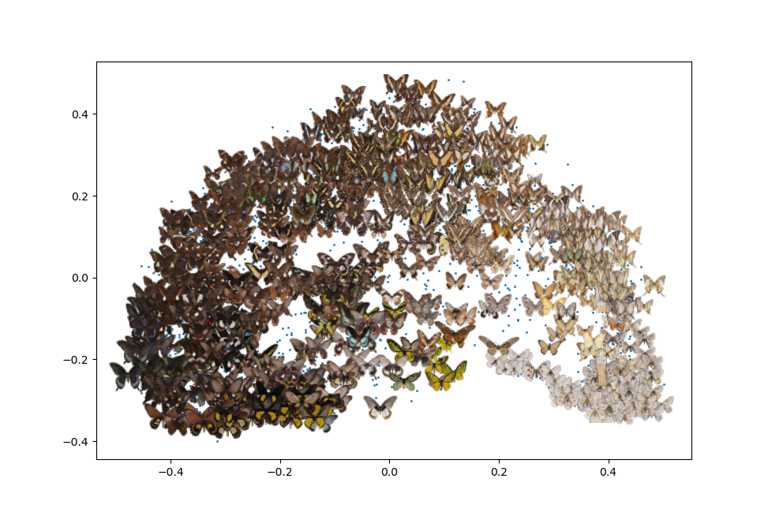
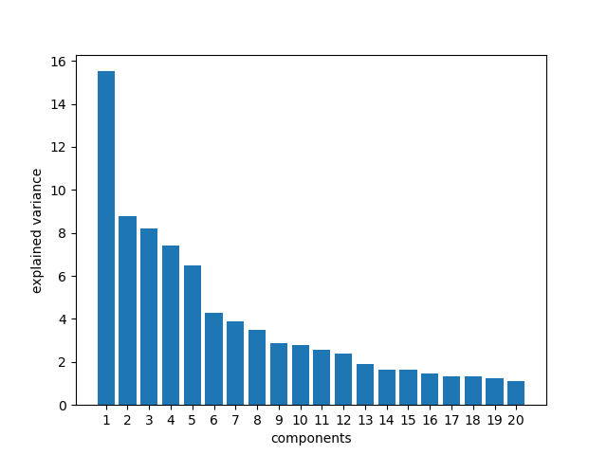
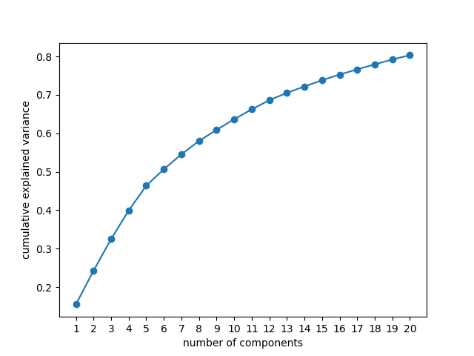
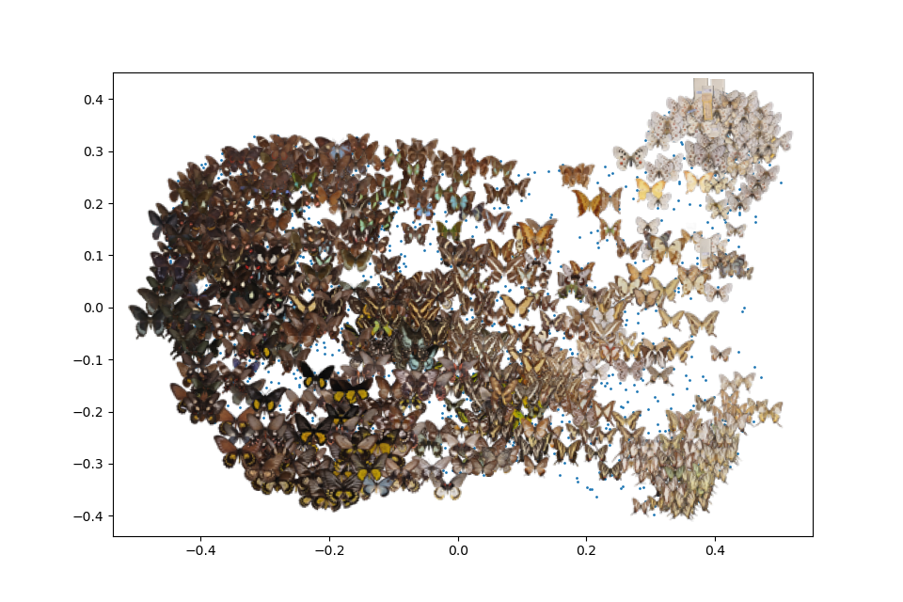
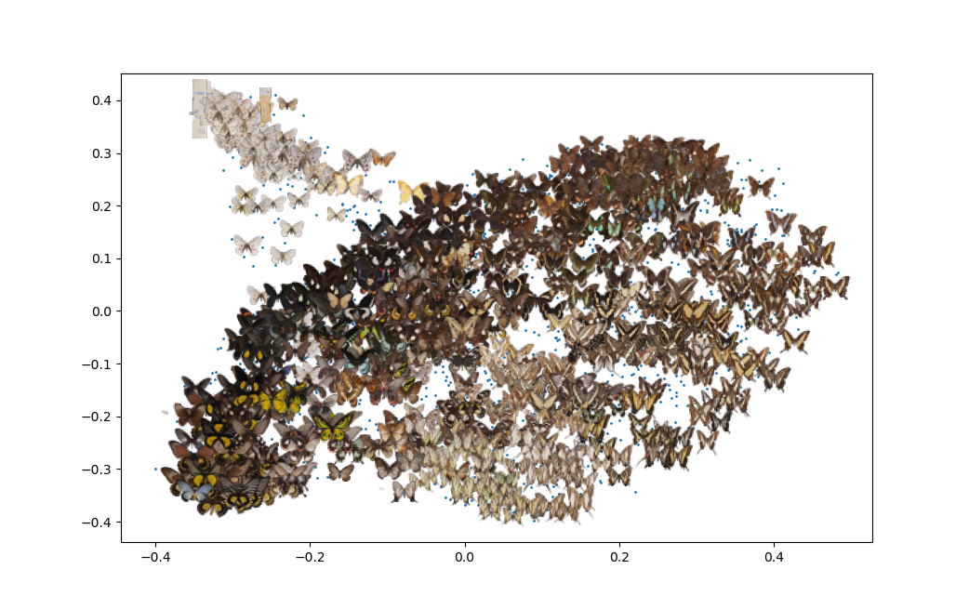
Morpho space
ACP
ACP
2048
20 -
~80%
PC2
PC1
PC3
PC3
PC1
PC2

Slide 39
The code

Slide 40

On my github (https://github.com/AgathePuissant), download the code « SimCLR_GUI.py » from the XXX project. It may be updated if I implement or correct errors.
The code contains:
Model training
Generating embeddings from a trained model
Model validation
GradCam visualisation
Wrapped in a GUI. It can be modified as needed in your local copy.
Separately to run in anaconda console: Scatterplot visualisation of the images

Slide 41
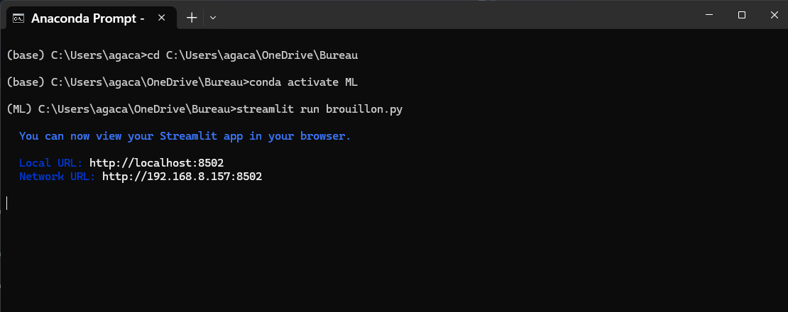
To run the code :
Open « Anaconda prompt », and change the directory to the one containing the .py file (type cd path/to/directory)
If needed, load the environment containing the packages (type conda activate nameofenvironement
conda install spyder
pip install -r requirements.txt
Type « streamlit run file.py » and it should open a webpage.

Slide 42
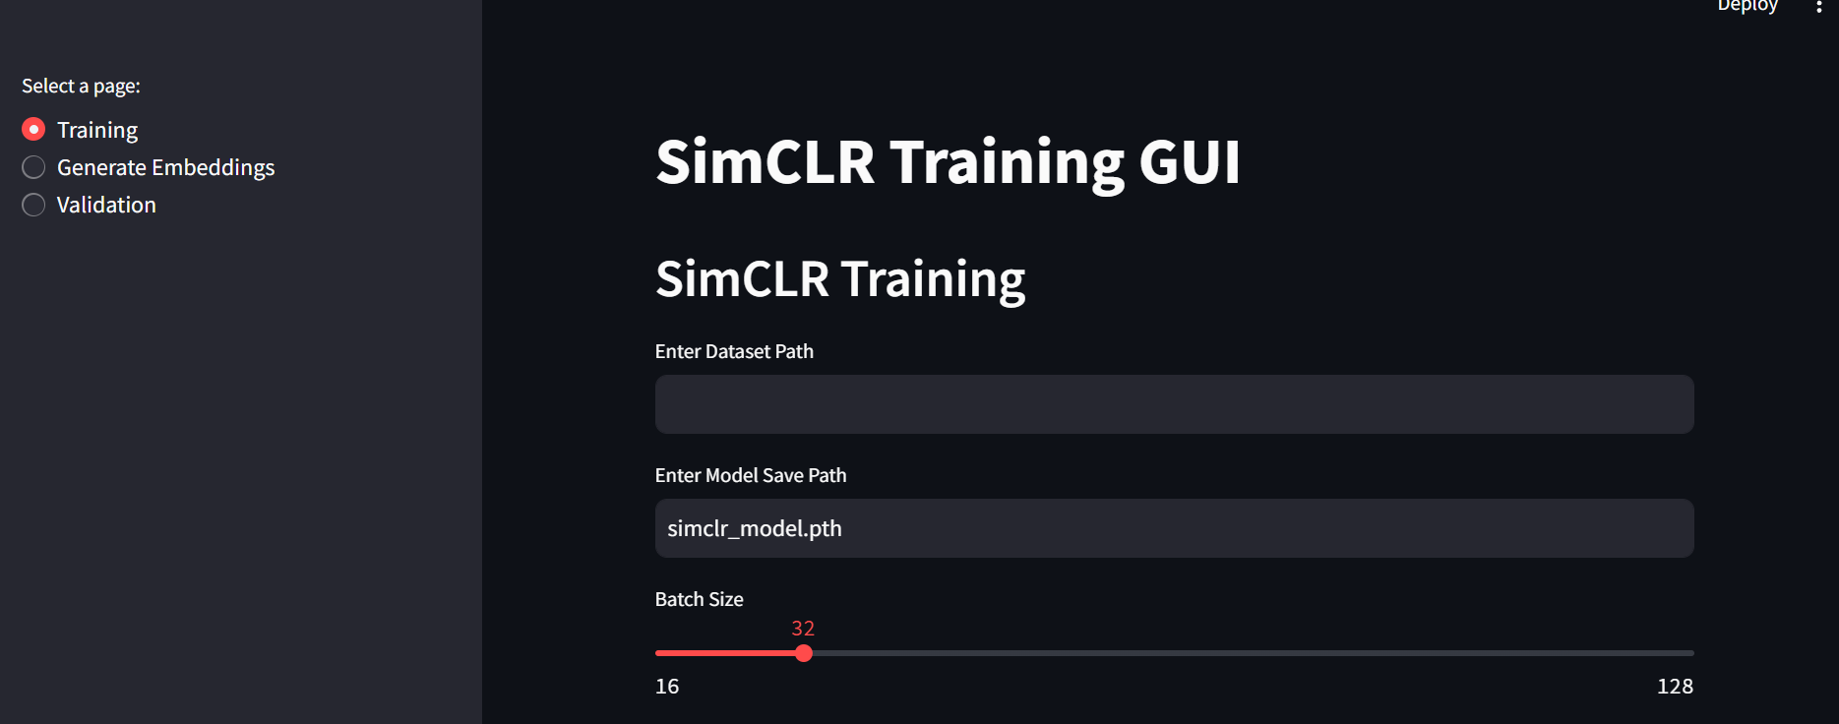
Slides for each part of the code

Slide 43
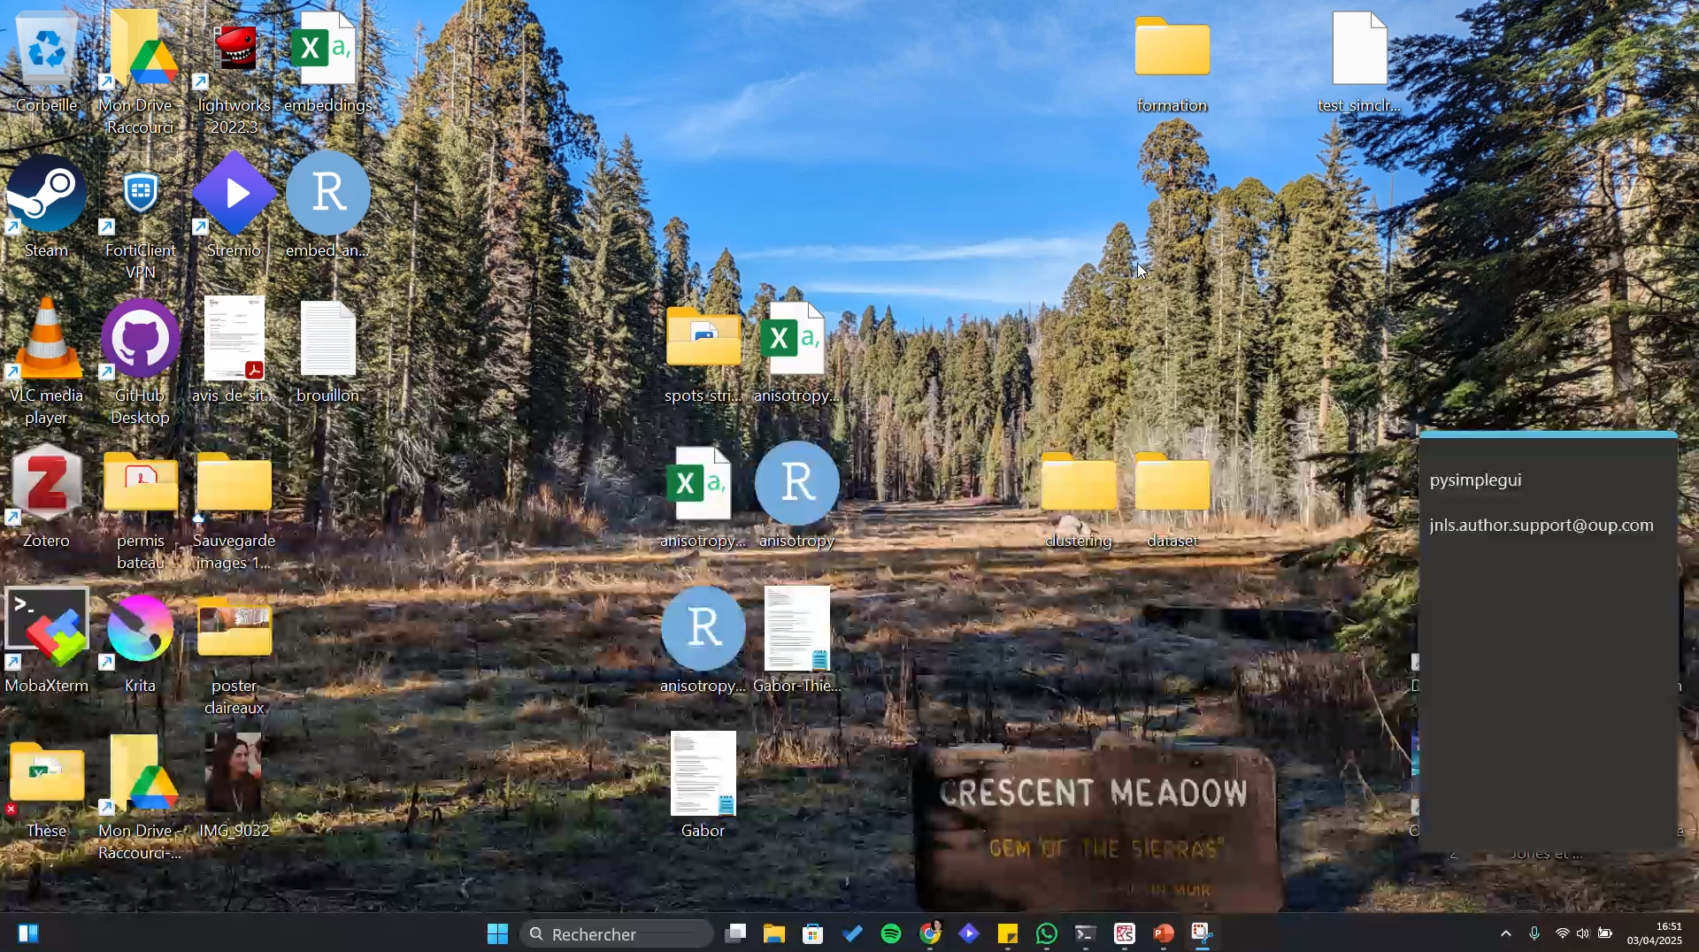
Dataset format
A folder, containing either the images directly, or folders corresponding to image labels for dataset balancing and/or validation.

Slide 44
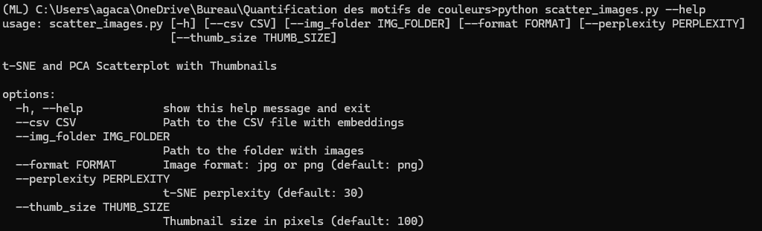
Large batch size means more GPU memory needed and often results in slower code, but generally leads to better results with SimCLR.
Scatter plot with images

Slide 45
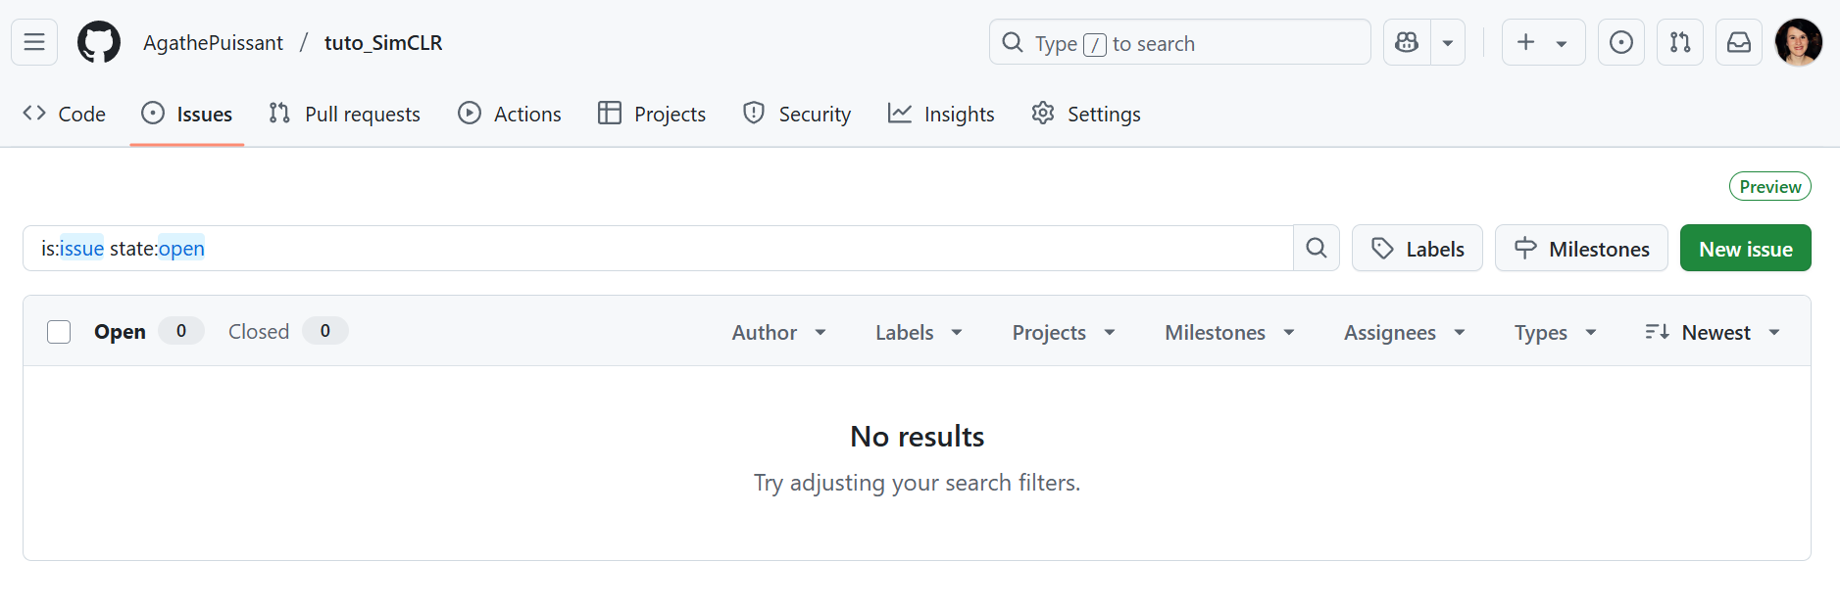
To be added :
auto hyperparameter grid-search
Hardcoded version to launch on a cluster
For butterflies : auto segmentation of wings
A code to find coarse phenotypic clusters
?
If there is an issue

